Slide 1
Creating and theming a profile card layout
Module introduction
Profile layout Composable
Image Composable
Theme in Compose
Customizing colors
Scaffold and AppBar Composables
Customizing shapes
Customizing typographies/fonts
Add multiple users to layout with dynamic input

Slide 2
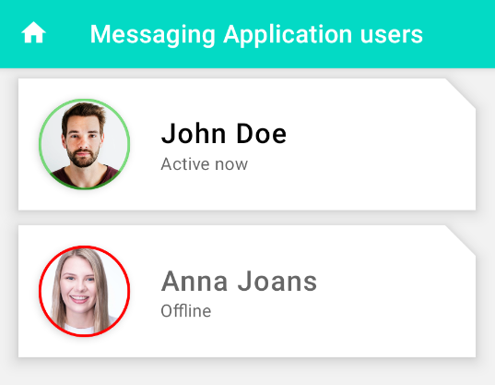
Creating and theming a profile card layout
Module introduction

